Slide 1
Customer Behavior Analysis
Introduction
In early 2021, Danny opened a Japanese food restaurant named Danny’s Diner, offering his three favorite dishes: sushi, curry, and ramen.
To improve customer experience and loyalty, Danny wants to analyze customer data to understand their visiting patterns, spending behavior, and menu preferences.
This project aims to provide insights using SQL queries to help Danny make informed business decisions.

Slide 2
Dataset Overview
Sales: Records of all customer purchases, including customer ID, order date, and product ID.
Menu: Details of menu items, including product ID, product name, and price.
Members: Information on customer membership, including customer ID and join date.

Slide 3
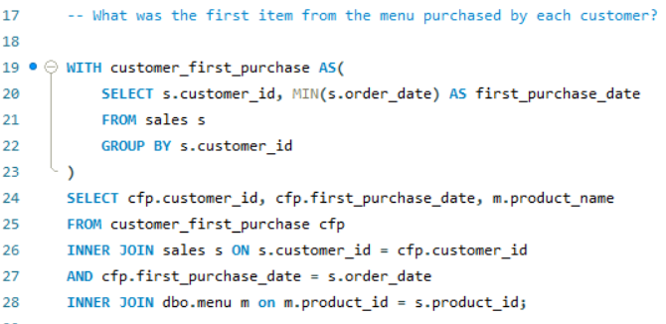
SQL Queries and Insights
First Item Purchased by Each Customer

Slide 4
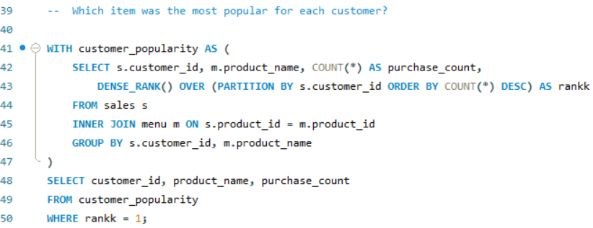
SQL Queries and Insights
Most Popular Item for Each Customer

Slide 5
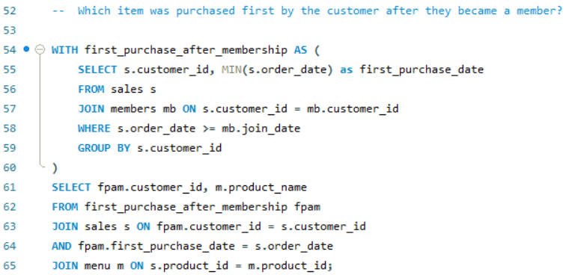
SQL Queries and Insights
First Item Purchased After Becoming a Member

Slide 6
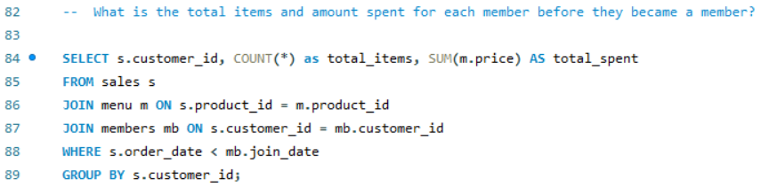
SQL Queries and Insights
Total Items and Amount Spent Before Becoming a Member

Slide 7
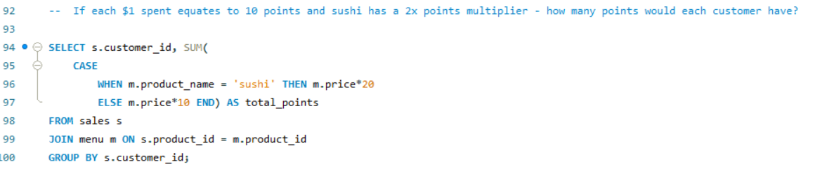
SQL Queries and Insights
Customer Points Calculation

Slide 8
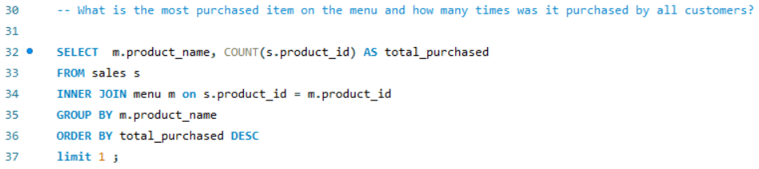
SQL Queries and Insights
Most Purchased Item on the Menu

Slide 9
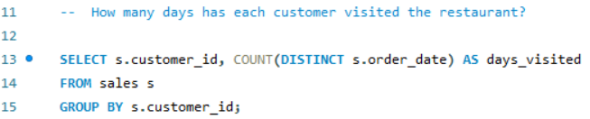
SQL Queries and Insights
Number of Days Each Customer Visited the Restaurant

Slide 10
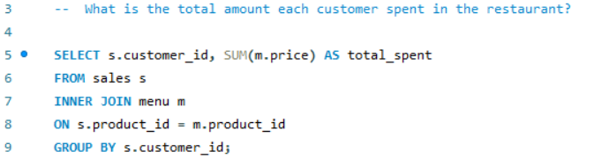
SQL Queries and Insights
Total Amount Spent by Each Customer

Slide 11
Conclusion : - This analysis provided Danny with valuable insights into customer behavior, spending patterns, and product preferences. - By leveraging these insights, Danny can enhance the customer experience, tailor promotions, and make informed decisions about expanding the loyalty program. - This project demonstrates the power of SQL in transforming raw data into actionable business intelligence. Recommendations : - Implement targeted marketing strategies based on customer preferences. Develop personalized offers for loyal customers. - Continuously monitor and analyze sales data to identify new trends. Explore additional data sources for a more comprehensive analysis.

